Slide 1


Primary school transitions
Katie Hill
May 2026

Slide 2

What does it mean to be ready for school
School readiness is about life skills. The starting reception definition provides a list of these skills, themes under four pillars.
Growing independence.
( eating, dressing, using a toilet independently)
2. Building relationships and communicating.
( taking turns, sharing feelings and follow instructions)
3. Physical development
(climbing and jumping, using scissors)
4. Healthy routines
(going to bed at around the same time each night and limiting screen time)

Slide 3
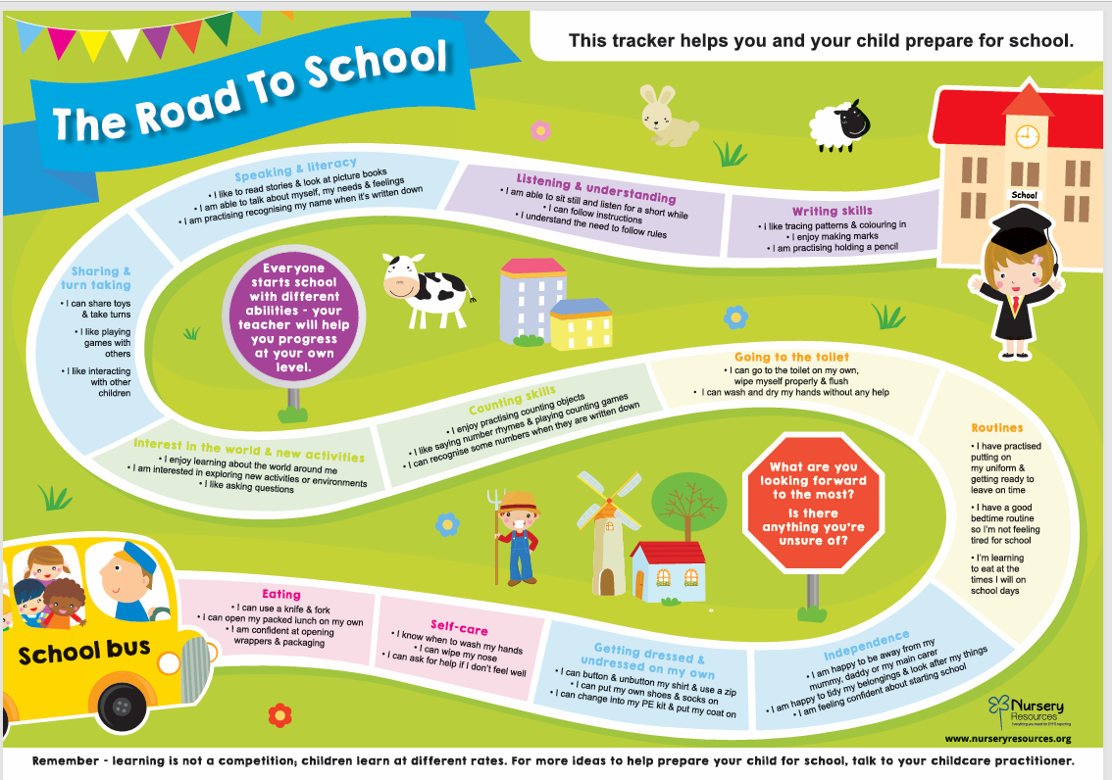

Slide 4

How the setting Supports Transition
Sharing information from the preschool setting
Gradual settling-in support where needed
Follow the road map to school in our planning and make sure all school leavers are ready to start reception.

Slide 5

How Parents Can Help
Read together every day
Encourage independence (toileting, dressing, tidying)
Talk positively about starting school
Practice listening and turn-taking skills
Maintain consistent bedtime and morning routines
Visits to the Reception classroom
Opportunities to meet staff and new classmates

Slide 6


Remember
Every child settles at their own pace.
We are here to work together to make
the transition a happy and positive
experience for all children.
FOR MORE IMFORMATION PLEASE GO TO:
https://www.checkendonpreschool.co.uk

